Slide 1


Supporting Residents with ABI in LTC
Presented By Rachael Henry,
ABI System Navigator
Notes:
Who am I and what do I do:
First point of contact open to anyone
Link people with resources and services in their communities
Provide education about brain injury
Collect data to help plan future services
If you have questions or need help, give me a call!

Slide 2
Brain Injury Defined
Damage to the brain, which occurs after birth and is not related to a birth disorder or a progressive disease.
Traumatic Brain Injury (TBI) may be caused by a violent movement of the head or penetrating injury, for example a car accident, fall, or shrapnel.
Acquired Brain Injury (ABI) caused by other sources such as an aneurism, brain tumour, or lack of oxygen.
Sometimes the term “ABI” used to refer to both ABI and TBI.

Slide 3
What is ABI System Navigation?
System Navigation provides support to anyone affected by brain injury: Survivors, Families, the Community, and Professionals
Ensures both clients and service providers have a comprehensive awareness of potential resources
Ongoing support throughout the referral and needs assessment process to ensure needs are fully met
If you are wondering what to do, give us a call!
Notes:
Who am I and what do I do:
First point of contact open to anyone
Link people with resources and services in their communities
Provide education about brain injury
Collect data to help plan future services
If you have questions or need help, give me a call!

Slide 4

Brain Facts
Contains 200 billion neurons (Nerve cells)
Weighs approximately 3 pounds
Each neuron connects (on average) to 50 other neurons
Two distinct components: White Matter and Grey Matter
Components include Cortex, Corpus Callosum, Cerebellum, Brain Stem
Notes:
*GET OUT MODEL BRAIN*
Grey matter – cell body or nucleus
White matter – connecting fibers (axons and dendrites)
Components:
CORTEX
Largest part, controls most thinking functions, divided into left and right hemispheres as well as four “lobes” (frontal, temporal, parietal and occipital) which are specialized in certain skills or functions.
Corpus Callosum
largest white matter structure, connects left and right hemispheres
CEREBELLUM
“little brain” at back of head, Responsible for coordination, smoothness of movement. Newer research suggests it also plays a role in cognitive functions such as attention and language, and in regulating fear and pleasure responses
BRAIN STEM
Life support system of the body
Controls consciousness, breathing, blood circulation, swallowing and temperature regulation.

Slide 5
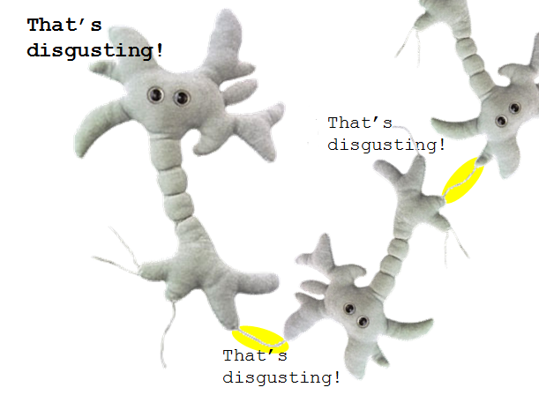

How your brain works:
Notes:
Neurons work as a network, passing information along pathways to each other.
Neurons do not actually touch, but communicate through electrical and chemical signals.
If the neurons move out of alignment, this connection can be lost.
When one area of neurons becomes damaged and dies, they are unable to pass signals along to neurons further down the chain.
When these neurons are no longer receiving information, they can atrophy and cause cell death far from the initial injury site.

Slide 6
What does the brain control?

Slide 7
Your Brain Controls:
Emotions and Mood
Our 5 Senses
Hormonal regulation
Brain chemistry
Sleep and wakefulness
Alertness, concentration, and attention
Movement and balance
Strength
Speed
Speaking and understanding language
Organization and planning

Slide 8
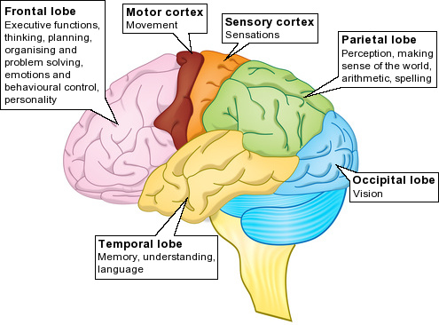

Slide 9
Most common areas for TBI

Slide 10
Mild, Moderate and Severe
Classified by 2 factors:
Length of loss of consciousness ( LOC) or post-traumatic amnesia (PTA)
Glasgow Coma Scale (GCS)
Severe: LOC and/or PTA more than 24 hours,
GCS: 3-8
Moderate: LOC and/or PTA more than 30 min, but less than 24 hrs.
GCS: 9-12
Mild: LOC and/or PTA under 30 min,
GCS 13-15
Concussions are classified as mTBI
Notes:
Glasgow Coma Scale (GCS):
Three categories: eye opening, best motor response, verbal response
Scoring ranges from 3 to 15 – below 3 – you’re not alive.

Slide 11
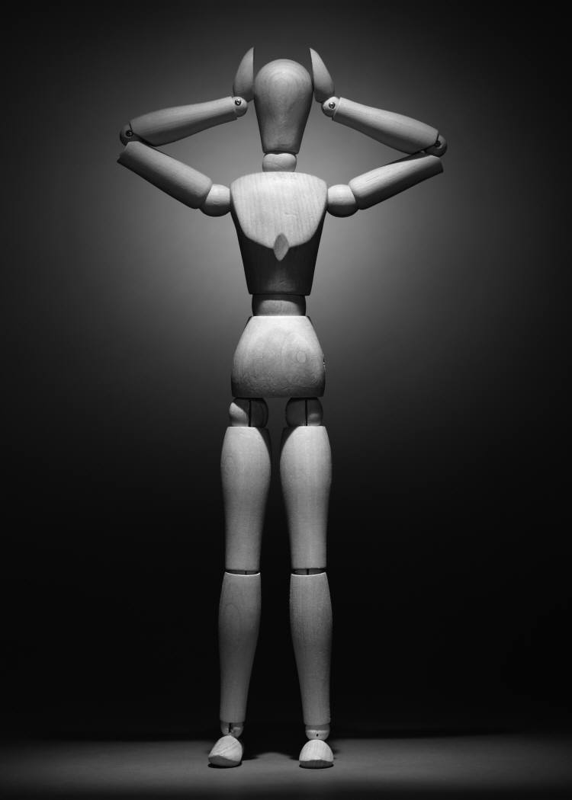
Brain Injury Symptoms
Brain Injury Impacts Many Areas
Medical
Physical
Sensory
Thoughts and Communication
Behaviour and Personality
Notes:
Medical: headaches, risk of seizures, changes in appetite, fatigue – both mental and physical
Physical: balance, slower reactions, lack of coordination, weakness or paralysis,
Senses: over-sensitivity, vision problems, sensitivity to noise, changes to sense of smell and taste, single-sided neglect
Thoughts and Communication: can affect organization of thoughts or ability to find words and communicate clearly; not necessarily the same thing – some people have clear thoughts but can’t translate into speech
Behaviour and Personality: irritability or mood swings, impulsivity, agitation, impaired judgment or decision making ability, lack of insight or awareness of problems, anxiety or depression, restlessness, trouble sleeping

Slide 12

An Invisible Injury
The survivor’s struggles aren’t always apparent to others
Difficulties with fatigue, attention, mood, and pain cannot be seen
Don’t make assumptions about what they can or cannot do – Ask the survivor or someone who knows them well.
With practice, some survivors can learn to tell others how to help. Eg. “My memory is terrible. Can you write that down?”

Slide 13
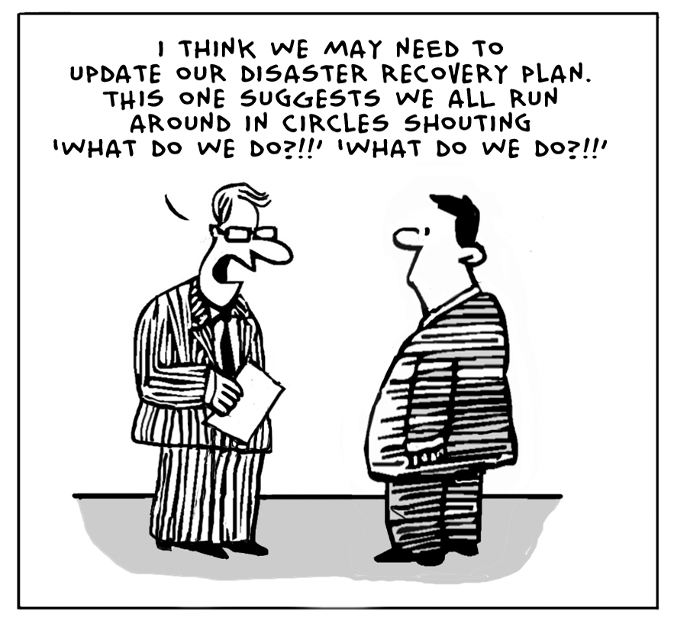
Recovery
Notes:
Don’t we all have these days?
It’s important to recognize that many factors contribute to a good recovery, and that learning strategies can make all the difference in terms of how one is able to cope.
Not always about getting back to the state you were in prior to getting injured, but about learning how to get on with life with a new set of circumstances.
Learning cognitive strategies for someone with a brain injury is like someone who is a new paraplegic learning to use a wheelchair. It doesn’t make the injury go away but it will make things much easier.

Slide 14
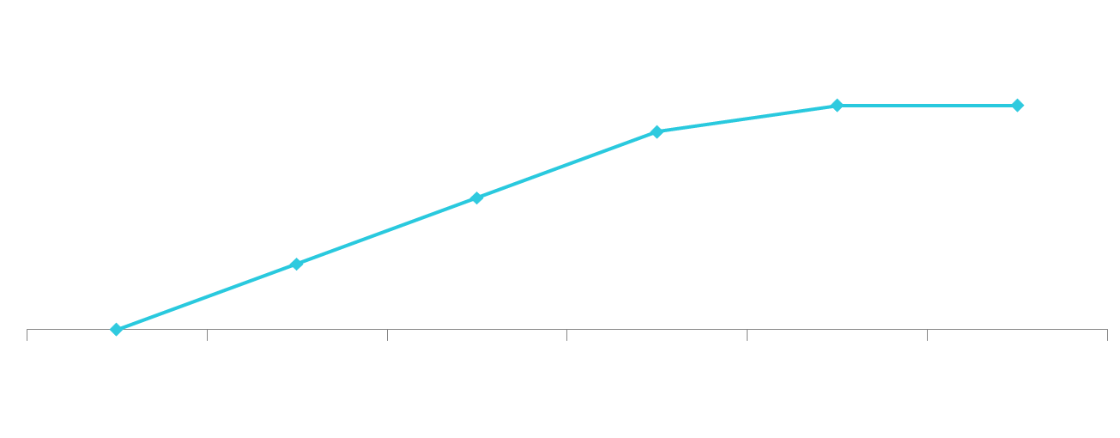
Recovery
Mild | Day 1 | Day 3 | Day 7 | Month 2 | Month 3
Moderate | 8 weeks | 6 months | One Year | Two Years | Three Years
Severe | 6 Months | One Year | Two years | Three Years | Four Years

Slide 15
What Affects Recovery?
Age
Health
Seriousness of Injury
Early medical care
Length of coma
Amount of time since injury
Pre-injury personality and abilities
Quality of rehabilitation and support

Slide 16
How and When?
Begins within 24 hours and continues for a lifetime.
Brain chemistry slowly returns to normal.
Injured neurons repair and come back online.
Neuroplasticity occurs – new routes to share information are formed, uninjured areas of the brain take over from injured areas
Some things will be the same as before the injury – others will be very different.

Slide 17
What is different about Brain Injury?
Although a person may experience cognitive difficulties after brain injury, there are several things to keep in mind:
Recovery is ongoing. It may slow over time but never ends
Some thought processes may be affected and others completely unaffected
Memories from before the injury remain
The more a person with a brain injury can be taught and practice strategies to manage their thinking problems, the more independent they will become
Notes:
Groves in the road analogy

Slide 18
Consequences of
Injury to the Brain

Slide 19
Cognitive Difficulties
Each individual is unique and each brain injury is different. The approach you take must factor in the individuals strengths and challenges in order to be successful.

Slide 20
Stroop Test
BLUE
YELLOW
BLUE
GREEN
BLUE
GREEN
GREEN
RED
YELLOW

Slide 21
Living in the Moment Video Clip:
Emotional and Physical Changes

Slide 22
Strategies
I can do this better, faster and with less effort – why should I make them do it?
Strategies allow people to:
Regain independence
Have better self-esteem
Feel less frustrated and more in control
Live to their fullest potential

Slide 23
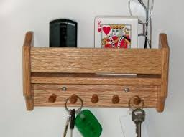
Memory
Memory impairment is a significant challenge for many brain injury survivors.
Things you can do to help:
Keep things in the same place
Keep important information in a binder or folder all together
Label cupboards and drawers
Develop daily and weekly routines

Slide 24
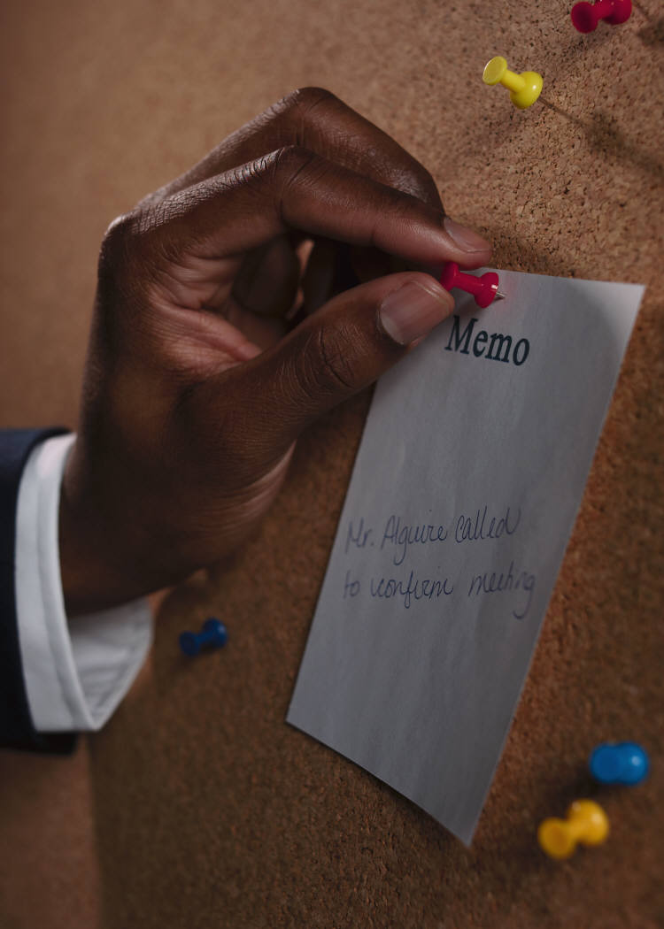
Memory
Calendars or journals of past events and future plans
Post-It notes or whiteboards
Instructions should be clear and concise

Slide 25
Attention
People with brain injuries often lose the ability to filter out background noise and ignore distractions.
You can help by:
Find an area free of distractions, noises, etc.
Finish one task/ topic before starting another (no multitasking allowed!)
Ask questions
Monitor for signs of fatigue and focus
Take a break to refresh or reschedule

Slide 26
Organization and Planning
Some people need help making plans and getting organized. Some strategies include:
“To Do” lists
Schedule activities in your day planner/calendar
Cue to “Stop and Think”
Plan steps to activities together
Use past experiences with something similar to help prepare

Slide 27
Organization and Planning
Staying On Task:
For appointments/meetings: Help residents generate a list of topics they want to discuss
Make sure goals are reasonable and attainable – talk it out with someone else
Provide gentle, respectful feedback
Problem solve as a group

Slide 28
Self-Awareness & Insight
It is difficult for some people to recognize the impact of their brain injury on their thinking. This is not denial but a loss of the ability to self-reflect or draw on memories of success or failure. This can also cause difficulties with self-regulation and emotional control.
You can deal with limited self-awareness by:
Work “behind the scenes” Get to know what activities they may struggle with – and taking steps to help them be successful
Providing feedback and reminders about past events
Providing information about how the brain injury affected them.
Being patient and not misinterpreting their behaviour!

Slide 29
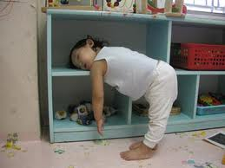
Coping with Fatigue

Slide 30
Fatigue
Fatigue is often the greatest challenge for someone after a brain injury. The injured brain needs takes extra effort to perform functions. This is called Mental Fatigue. Strategies include:
The 3 P’s: Prioritize, Plan, and Pace
Schedule activities at the beginning of the day, or the time the resident is most alert
Provide breaks or end the activity early
Consider the impact of the environment (high stimuli = more fatigue
Rule out other health factors (hypothyroidism, anemia, etc.)
Attend to emotional health. Symptoms of depression or other mental health concerns can include fatigue.

Slide 31
Fatigue
Good Sleep Habits
Limit caffeine intake later in the day
Sunshine, fresh air, and exercise
Keep a set bedtime and waking time. Most people need 6 – 8 hours of sleep, but some need more.
Develop a nighttime routine based on the resident’s preferences, for example read a book, have a bath, listen to soothing music, or have a cup of caffeine-free tea or hot milk.
Do deep breathing exercises to help with relaxation.
Avoid bright lights, televisions, and computer screens for at least half an hour before bed

Slide 32
Sensory System
Visual difficulties
Hearing difficulties
Dizziness
Pain
Proprioception – judging your body’s movements
Altered sensations of pressure, temperature, touch, taste and smell

Slide 33
Somatic marking
Using emotion to inform behaviour by marking memories with the appropriate feelings
Notes:
Why highly emotional events are easier to remember – true for our clients as well.

Slide 34
Problems related to Perception
Perception is the integration of sensory impressions into psychologically meaningful information.
It is how we understand and move through our daily world.

Slide 35
Perception Difficulties:
People with perception difficulties may have difficulty:
Finding their way around
Finding objects in their room
Recognizing objects
Self-monitoring and attending to all aspects of a task
Recognizing facial expressions or body language

Slide 36
Communication
Why is communication important with your clients?
What types of communication difficulties have you seen in others?
How have you dealt with communication problems in the past?

Slide 37
Communication:
Aphasia (8% of people)
Reduction in abilities of listening, speaking, reading and writing.
Often know what they want to say, but have trouble putting the right words together
Difficulties related to language content, form and use.
“Communicate better than they talk”

Slide 38
Cognitive-Communicative Problems
(90 + %)
Reduction in abilities related to use of language (verbal/non-verbal)
Related to cognition; If you have difficulty organizing your thoughts, your speech will be disorganized as well.
Typically diffuse/widespread damage.
“Talk better than they communicate”

Slide 39
Problems related to Communication
Beginning, maintaining, and ending a conversation
Digress off topic or lack continuous flow of thoughts
Ideas limited, unable to elaborate
Not following socially accepted rules
Poor turn taking skills
Decreased active listening skills
Difficulty finding right words
Rigid thinking; inability to accept alternative ideas
Difficulty recognizing and using body language
Lack or inappropriate facial expression or tone of voice
Increased likelihood of misunderstandings

Slide 40
Communication Strategies for Others
Tailor your approach to the individual
Speak clearly, slowly and in short phrases
Take your time to listen. Patience is key.
If you’re having difficulty understanding, provide feedback regarding difficulties with specific examples.
Reduce background noises ( i.e. TV, radio)
Ask questions to clarify
Restate previous points to help stay on topic.
When presenting novel information, offer to let people “think about it” for a while – they may need time to incorporate this idea
Be prepared to repeat yourself a few times!

Slide 41
Dealing with Emotions

Slide 42
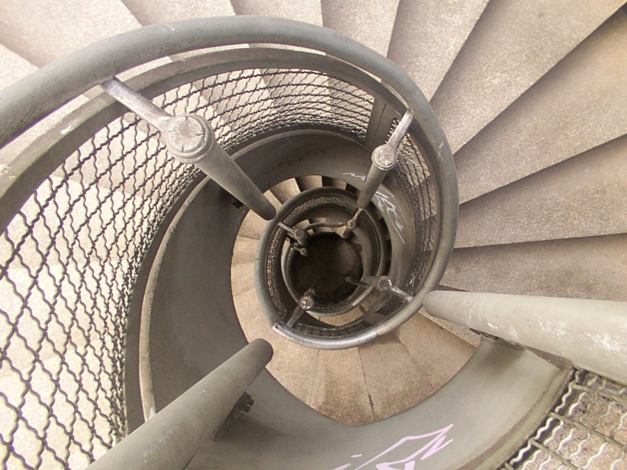
Emotions and Mental Health
Having a brain injury can increase your risk for certain mental health conditions
Can be caused by changes to thought processes and ability to control emotions, loss of abilities and freedoms, changes in relationships, difficulty coping
Improvements can occur in many ways: by learning new strategies, finding enjoyable activities, medications, or counselling

Slide 43
Living in the Moment Video Clip
What service providers need to know…from a brain injury survivor

Slide 44
Behavioural and Emotional Concerns
  Disinhibition: Not being able to stop thoughts or behaviour that may be inappropriate.
  Fluctuations in mood
  Denial, lack of awareness, and unrealistic expectations
  Egocentrism: Unable to see things from other’s perspective
  Rigid thinking; inability to accept alternative ideas
  Withdrawing from others
  Low frustration threshold, irritable, temper
  Impulsivity
  Lack of motivation or unable to initiate tasks
  Dependency
  Impact of pain or stress

Slide 45
Strategies for Behavioural and Emotional Problems
Two Options:
Change the person (with brain injury this can be hard sometimes…)
Change the situation (usually easier to do)

Slide 46
Personal Changes
Using Cognitive Behavioural Therapy to manage symptoms such as anxiety, low self-esteem, or depression
Relaxation exercises
Lot of repetition – procedural memory often still works, even if episodic memory doesn’t
Involve the person in plans to minimize loss of control and independence
Teach coping strategies that the individual can use on their own – eg. Checking a dayplanner

Slide 47
Triggers!
We all have them:
Internal External
Fatigue Lack of Choice & Control
Hunger Particular Individuals
Grief & Sadness Changes in routine
Medication Noise
Illness & Pain Holidays
Hormones Weather
Blood Sugar Other’s expectations

Slide 48
Environmental Changes
Be proactive – find ways to engage the individual in activity and feel positive about themselves (Montessori)
Address needs proactively and promptly such as pain, hunger, loneliness or boredom
Provide the opportunity to be successful & give praise
Avoiding triggers
Noticing early warning signals
Take a break before emotions escalate
Give warning if you need to talk about or do something difficult

Slide 49
Early Warning Signals
Physical Symptoms Heart racing Clenching muscles Racing thoughts Butterflies / feeling in pit of stomach Pain, Headaches Digestive issues Holding breath Restlessness Lump in throat Feeling overwhelmed, difficulty focusing | Observable Signs Sighing Breathing heavily Tense body posture Repeatedly talking about the same topic Complaints of stomach ache, headache, pain, dizziness Fidgeting Pacing Clearing throat Tearfulness Less coherent or focused; unable to answer questions clearly, follow directions Zoning out

Slide 50
Environmental Changes
Providing opportunities to talk about concerns
Redirecting or distracting from the problem
Directing the resident to a quiet space where they can calm down naturally
Avoid distractions or stimulus overload
Be aware of factors such as fatigue, pain, or stress – don’t push someone past their tolerance level
Write things down to reinforce understanding
Provide with respect and empathy
Stating clear, consistent expectations
GPA works with ABI too!

Slide 51
Medication and Restraints
Although physical restraints or medications are sometimes useful in controlling behaviour, they place patients at risk and can sometimes escalate the situation
Clients with brain injury may be made more confused and agitated when medicated or restrained
They may struggle and injure themselves or others
Medications can cause negative side effects
Because of this restraints should be used only as a last resort & by someone with knowledge in ABI

Slide 52
Adjusting to Change
Stages of Grief and Loss: Dr. Roberta Temes
Numbness (mechanical functioning and social insulation)
Disorganization (intensely painful feelings of loss)
Reorganization (re-entry into a more 'normal' social life.)

Slide 53
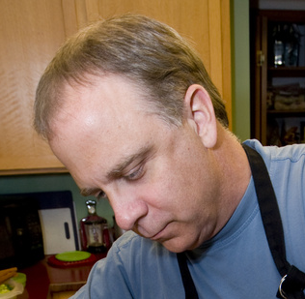
Case Study: Jack
Jack is a resident in a long term care home, where he was forced to move after experiencing a brain aneurysm. He is 40 years old and separated from his wife. Staff express difficulty in managing Jack’s behaviour when he becomes upset, which can include yelling, swearing, and grabbing at them. Some feel he shouldn’t be allowed to remain at the home…

Slide 54
Questions:
What might be affecting Jack’s behaviour?
What do we need to know more about?
What are some possible solutions?

Slide 55
If you need help related to brain injury, get in touch!
613-547-6969 ext. 165 henryr1@providencecare.ca
Thanks for being here!

